Slide 1
UE21CS390A – Capstone Project Review #2
(Project Requirements Specification and Literature Survey)
Project Title : Traffix: Dynamic Scheduling of Traffic
Signals Using Machine Learning
Project ID : 34
Project Guide : Dr. Mannar Mannan
Project Team : Kushaagra Shrivastava PES2UG21CS917
Harshita Khajuria PES2UG21CS194
Rishab A Kumar PES2UG21CS429
Rahul G Pai PES2UG21CS414

Slide 2
Outline
Abstract
Motivation Scope of the Project
Suggestions from Review – 1
Functional and Non - Functional Requirements
Literature Survey
Capstone (Phase-I & Phase-II) Project Timeline
Conclusion
References

Slide 3
Abstract
The project aims to solve the problem of traffic congestion at signals by dynamically scheduling signals using machine learning and real time data processing.
This enhances traffic efficiency, reduce congestion, and improve overall transportation system performance.

Slide 4
Motivation and Scope of the Project
This project focuses on revolutionizing urban and suburban traffic management through real-time adjustments of traffic signal timings.
The goal is to minimize congestion, enhance vehicle flow efficiency, and reduce average commute times.
Intersections, signals, roads in urban/suburban areas.
Seamless integration with existing infrastructure.

Slide 5
Suggestions from Review – 1
The panel members recommended referencing a recent paper and highlighting the distinctive features of our project in comparison to theirs.
The panel also emphasized the importance of collecting data from GPS sources rather than opting for image processing.
We will be going ahead with the suggestions as they are feasible and streamlines data collection process

Slide 6
User Classes and Characteristics
Summarize each user class and its characteristics.
Traffic Management Authorities:Full control for real-time monitoring and traffic signal adjustments.
City Planners and Analysts:Access to historical data and simulation tools for urban planning.
Regular Commuters:Manages traffic signal efficiently, hence regular commuters benefit from it.

Slide 7
Constraints / Dependencies / Assumptions / Risks
Constraints:
Regulatory Policies: Adherence to local and national traffic regulations and policies may limit the flexibility of certain features, particularly in areas with strict regulatory control over traffic signal operations.
Hardware Limitations: Signal timing requirements and limitations of existing traffic signal controllers may constrain the system's ability to implement certain adaptive traffic control strategies.
Dependencies on simulation programs may impose constraints on the accuracy and flexibility of traffic modeling.

Slide 8
Constraints / Dependencies / Assumptions / Risks
Assumptions:
Parallel Operations: Assumes parallel operations of the existing traffic management systems, and the dynamic traffic scheduling system will complement rather than replace traditional static systems during the initial implementation.
Criticality of Application: Assumes a critical need for real-time traffic management but acknowledges that the dynamic system may not be the sole solution for all scenarios, and traditional methods may still be required in certain situations.
Safety and Security Considerations: Assumes a commitment to safety and security considerations, emphasizing the implementation of secure communication protocols and measures to prevent unauthorized access and malicious activities.

Slide 9
Constraints / Dependencies / Assumptions / Risks
Risks:
Data Reliability: The risk of compromised traffic management due to inaccuracies or delays in real-time data from various sources.Community Acceptance: Resistance or slow adoption by the community may hinder the effectiveness of dynamic traffic scheduling practices.
Security Vulnerabilities:Potential breaches may compromise the confidentiality and integrity of sensitive traffic data, posing risks to system security.

Slide 10
Functional Requirements
User Interfaces
Web app based for demonstration of the project. Final project won’t have a defined GUI for the users
Software Requirements
MySQL Database / Cloud Bucket Storage
Python 3.10+
PyTorch OR TensorFlow APIs
Cloud Compute Architecture

Slide 11
Functional Requirements
Hardware Requirements
CPU: A processor with capabilities equivalent to or surpassing the Intel Core i5 6th Generation.
RAM: Minimum 8GB RAM to ensure smooth operation and efficient handling of real-time traffic data.
Operating System: Compatibility with Windows 10 or higher versions for optimal performance.
GPU: NVIDIA GeForce GTX 960 or a superior graphics processing unit to support advanced visualizations and simulations.

Slide 12
Non - Functional Requirements
Performance Requirement
Capable of real time data processing
Reliable signal time output
Other Requirements
Portable - Should work on Lightweight Thin Hosts
Scalability - Architecture should be able to handle multiple similar requests from different traffic signals
Response Time - Should be capable of real time data processing

Slide 13
Non - Functional Requirements
Safety Requirements
Don’t let 2 lanes that could probably collide go green at the same time
Security Requirements
Should be invulnerable to attacks trying to feed wrong data to models to mess up traffic signal timings
Dataset should be from accurate source

Slide 14
Literature Survey
Paper Details | Objective of paper, Techniques/Methods | Advantages | Limitations
Sai Charan Kanigolla, Chaitanya kumar Avala, Likhith Sai kuna, K.L.V. Sai Prakash Sakuru “Smart Traffic Detection and Control using Machine Learning Techniques” 2023 5th International Conference on Energy, Power and Environment: Towards Flexible Green Energy Technologies (ICEPE) | In the modern era, with the rise in vehicles and population, many urban cities have faced traffic problems like traffic congestion, which causes travel delays. The main reason for the delay is that current traffic systems use fixed signal timers at the traffic signal intersection. These unnecessary delays at the traffic signals lead to excessive fuel consumption and increased pollution. This paper uses vehicle detection methods through surveillance cameras and machine learning to predict traffic based on historical data in a region. Finally, optimizing traffic by utilizing the predicted data and proposed methodology reduces the average wait time of travellers. Done using Object detection. | Dynamically allocates signal time for a given lane using a traditional algorithm | Done only for one lane at a time, i.e., only 1 lane is free at a time and not multiple, the way it works in the real world Done only for a up front POV

Slide 15
Literature Survey
Paper Details | Objective of paper, Techniques/Methods | Advantages | Limitations
Nitin N. Sakhare, Subhash B. Tatale, Dr. S. R. Sakhare, Hemant Dusaane , Mamta Puri, Pratika Girme ,Rutuja Sankpal, Padmavati Ghule “Image Processing and IoT Based Dynamic Traffic Management System” International Journal of Scientific Research in Science Engineering and Technology(2020) | Due to rise in number of vehicles the traffic management has become a major problem. Manual traffic system is not efficient. This paper presents adaptive traffic management system using Internet of Things (IoT) and Image processing. The proposed system has capability to analyze real time data using image processing. Using cameras, different lanes are monitored constantly. The data obtained from different lanes are examined. Detection and counting of number of vehicles in each lane is done by using image processing. The count from each lane is sent to the central processing unit. According to the count of vehicles algorithm calculates waiting time for each lane, then the signal lights will be decided. This system reduces the average waiting time and increases the efficiency of traffic clearance. The system also reduces the pollution due CO2 emission and useful in emergency situations, thus being adaptive traffic management using Internet of Things (IoT) Methodology-Detects and counts number of vehicles from camera Calculates wait and go time based on that | Algorithm to greenlight lanes is present Dynamic adjustment of traffic lights for all lanes is present | Only greenlights 1 lane at a time.

Slide 16
Literature Survey
Paper Details | Objective of paper, Techniques/Methods | Advantages | Limitations
Abhay KP, Bhavik M, Narendra M, Saket CS, Prof. Ruby Dinakar “Smart Traffic Management and Control System” | The rapid increase in urbanization and population growth has led to an exponential increase in the number of vehicles on the road. This leads to higher traffic congestion. Traditional systems have struggled to keep up with this growth. Traditional traffic management systems are static in nature, they cannot adapt to incoming traffic in real time. This system uses real time data and algorithms to calculate and assign efficient traffic signal timings based on incoming traffic flow. This is done using image processing with the help of YOLO, and a traditional algorithm to assign signal timings. | Categorizing of vehicles into Big, Medium, Small using YOLO’s image recognition, assigning different weights to each class of vehicle and calculating how much traffic they would cause, then aggregating it all to get increase in signal timing | The algorithm is only applied where the signal is already green, and it would modify timings there. It also only calculated traffic until a certain point which could be extremely close to the signal itself. Its not reprioritizing lanes as traffic builds up in other lanes

Slide 17
Literature Survey
Paper Details | Objective of paper, Techniques/Methods | Advantages | Limitations
Neetesh Kumar, Syed Shameerur Rahman “Deep Reinforcement Learning with Vehicle Heterogeneity Based Traffic Light Control for Intelligent Transportation System” 2019 IEEE International Conference on Industrial Internet (ICII) | Objective of paper - to make dynamic traffic lights using deep reinforcement learning. Models - deep reinforcement learning using cnn and relu activation function. | It gives a basic idea of how reinforcement learning works for our project and how we can implement it on our test data. Has a pretty good result with 32% reduction in average wait time(validated through simulation | Data is from a radio - frequency identification sensor which isn’t easy to use and gives digital signals which needs to be read and deciphered. They haven't taken into account the size of vehicles and only taken position and speed of a vehicle. The size of a vehicle plays an important role in the traffic congestion.

Slide 18
Literature Survey
Paper Details | Objective of paper, Techniques/Methods | Advantages | Limitations
Marcin Korecki, Damian Dailisan, Dirk Helbing “How Well Do Reinforcement Learning Approaches Cope With Disruptions? The Case of Traffic Signal Control” IEEE Access ( Volume: 11) | Objective of the paper - to check how well reinforcement models work in cases of disruptions. (If a road is under construction etc.) Models - Reinforcement learning algorithms. | Advantages - It tells about the reinforcement model and how it is prone to disruptions and gives the solutions to the problem.(Analytic+ method is found to be the best). Analytic+ : An adaptive, self-organizing method relying on optimization and stabilization rules. Green times are varied | It is only a research paper on the limitations of reinforcement learning algorithms. Does not provide adequate insight on the models itself. It does not implement analytic+ method into ML models to test how well it integrates with existing models.

Slide 19
Literature Survey
Paper Details | Objective of paper, Techniques/Methods | Advantages | Limitations
Chen Zhang, Yugeng Xi, Dewei Li, Yunwen Xu “Data-Driven Model for Traffic Signal Control” 2018 37th Chinese Control Conference (CCC) | Objective of paper - to reduce the congestion time at traffic signals. Models - Hidden markov model. | It gives us a basic idea of how HMM can be used for our problem statement. They use HMM to get a dynamic approach which is what we are trying to implement. Works well for highly congested data. | They are using a prediction based approach to calculate the traffic congestion at a given time(which may or may not be true).

Slide 20
Summary of Literature Survey
Paper 1: Image processing & IoT for lane monitoring & dynamic control (Single lane focus again).
Paper 2: Machine learning for traffic prediction & flow (Limited to single lane control).
Paper 3: Real-time data & algorithms for signal timing (Lacks dynamic lane prioritization).
Paper 4: Deep reinforcement learning (Ignores vehicle size impact).
Paper 5: Reinforcement learning for disruptions (Limited model clarity).
Paper 6: Hidden Markov Model (Relies on prediction for congestion calculation).
Overall:
Valuable insights for traffic management improvement.
Highlight limitations in existing approaches (need for multi-lane control, vehicle size consideration, etc.).

Slide 21
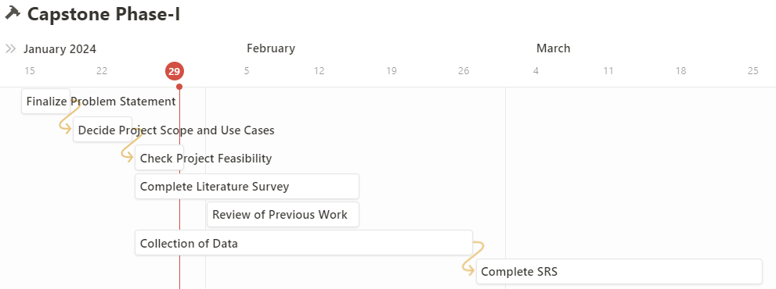
Capstone (Phase-I & Phase-II) Project Timeline

Slide 22
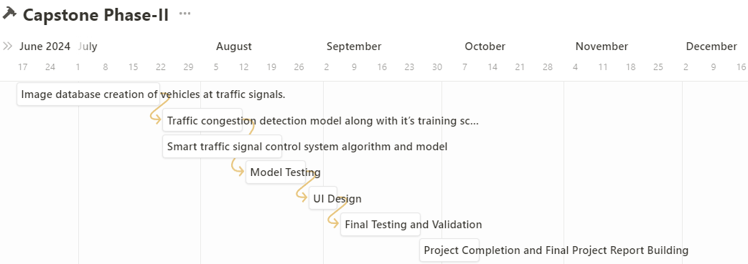
Capstone (Phase-I & Phase-II) Project Timeline

Slide 23
Conclusion
The document outlines the project "Traffix: Dynamic Scheduling of Traffic Signals Using Machine Learning" submitted by students at PES University.
Aims to reduce congestion, improve flow, optimize resource utilization in urban areas.
Features real-time monitoring, dynamic control, machine learning algorithms.
Focuses on performance, safety, security, scalability, reliability, and efficiency.

Slide 24
References
https://ieeexplore.ieee.org/document/10100954
https://ieeexplore.ieee.org/document/10201549
https://www.researchgate.net/publication/340458873_Image_Processing_and_IoT_Based_Dynamic_Traffic_Management_System
https://ieeexplore.ieee.org/document/9065034
https://ieeexplore.ieee.org/document/8483054

Slide 25
Thank You

